Slide 1
Darshana
Digital Cultural & Historical Storytelling Platform
A web-based platform that brings history, myths, folklore, and beliefs to life using AI, AR/VR, and gamification, creating immersive cultural journeys for tourists, students, and researchers.

Slide 2
Problem Statement
India has one of the richest cultural heritages in the world, but the way it is presented today is limited and fragmented. Most tourism platforms and guides focus only on dry historical facts and neglect the myths, folklore, and beliefs that give monuments meaning. There are no immersive experiences such as AR/VR or gamified exploration to engage modern audiences. Services like ticketing, travel, and guides are also scattered across platforms, making the tourism journey inconvenient.
As a result, cultural storytelling risks fading, and the younger generation struggles to connect with heritage.

Slide 3
Solution & Project Overview
Darshana is a cultural storytelling ecosystem where users experience monuments through multiple perspectives — verified history, local myths, folklore, beliefs, and even horror tales.
The platform integrates:
Narad AI, an intelligent cultural guide for chat and voice interactions.
Myth Summarization, delivering both detailed and quick story versions.
Virtual Visit, offering AR overlays and VR recreations.
Treasure Hunt and Gamification, making heritage exploration fun.
Multimedia Storytelling Hub, presenting stories as articles, podcasts, videos, and comics.
Vision: To preserve India’s heritage while reimagining storytelling for a modern, global audience.

Slide 4
Team members & responsibility
SN | Name of Student | Responsibility
1. | Thrista Dabas | UI/UX Designer
2. | Yashi Rai | Frontend Developer
3. | Soumya Maurya | Frontend Developer
4. | Roshan Rana | Frontend Developer
5. | Anshul Kumar | Backend Developer
6. | Varnit Agarwal | Backend Developer
7. | Ajay Tiwari | ML
8. | Nikhil Sharma | ML
9. | Nikhil Kumar | ML
10 | Jauwaad Bin Irshad | ML

Slide 5
Features of Darshana
Darshana offers a unique blend of AI, AR/VR, and cultural storytelling, making heritage exploration immersive and engaging.
Narad AI (Intelligent Cultural Guide)
Narad AI acts as an intelligent cultural guide, narrating official history, local traditions, and legends. At Badrinath Temple, for example, it tells the verified history, the myth of Nar and Narayan, and explains local beliefs in eternal flame lamps.
Interactive voice + chat assistant.
Narrates history, myths, folklore, and beliefs.
Includes audio help for hands-free exploration.
Example: At Badrinath Temple, Narad AI narrates the temple’s history, the myth of Nar and Narayan, and the belief in eternal flame lamps.

Slide 6
Features of Darshana
2. Myth Summarization
Myths can be long and complex. Darshana offers quick summaries for convenience while keeping detailed versions for enthusiasts. For instance, instead of narrating the full Mahabharata war, Narad AI highlights the core conflict in a short, engaging format.
Long myths condensed into 2–3 minute summaries.
Option to toggle between short and detailed narration.
Keeps content engaging and time-efficient.
Example: A concise version of the Mahabharata’s Kurukshetra War.

Slide 7
Features of Darshana
3. Virtual Visit (AR/VR Experiences)
Darshana makes heritage immersive. At Hampi, AR shows the mythical monkey army constructing the Ram Setu, while VR allows users to step into the legendary events of the Ramayana. This makes history interactive and visual.
AR overlays when pointing a phone at monuments.
VR recreations allow users to step into legendary events.
Example: At Hampi, see the monkey army building Ram Setu (Ramayana).

Slide 8
Features of Darshana
4. Treasure Hunt & Gamification
Gamification adds fun to learning. At Bhangarh Fort, users might solve riddles leading to the cursed legend of the fort. This feature especially appeals to Gen Z tourists, blending adventure with culture.
Myth-based puzzles and folklore riddles.
Unlock hidden stories, badges, and rewards.
Engages tourists, especially youth and students.
Example: At Bhangarh Fort, a riddle reveals the legend of the curse.

Slide 9
Features of Darshana
5. Multimedia Storytelling Hub
Darshana offers a content-rich library for cultural exploration. Users can read articles, listen to AI-narrated podcasts, watch animated videos, or enjoy illustrated comics. This ensures everyone finds their preferred way to experience culture.
Stories via articles, podcasts, video, audio and comics.
Categories: History, Myths, Horror, Beliefs

Slide 10
Features of Darshana
6. Monument & Place Information Hub
Each monument has layered storytelling. For example, the Taj Mahal shows Shah Jahan’s history, the myth of a “Black Taj,” and folklore of workers’ sacrifices. This gives users a 360° cultural perspective.
Each monument has three storytelling layers:
Verified History.
Myths & Beliefs.
Folklore & Horror Tales.

Slide 11
Features of Darshana
7. Ticketing & Travel Integration
Darshana integrates tourism logistics. For instance, booking a Fatehpur Sikri ticket also unlocks Akbar’s history, myths of Salim Chishti’s tomb, and ghostly tales of abandoned palaces, while offering smooth transport options.
QR-based ticketing in partnership with state tourism boards.
Integrated with Uber, Ola, and Rapido for seamless travel.
Bundled heritage circuits and packages for tourists.
Example: A Fatehpur Sikri ticket unlocks Akbar’s history, Salim Chishti’s myths, and ghost tales of abandoned palaces.

Slide 12
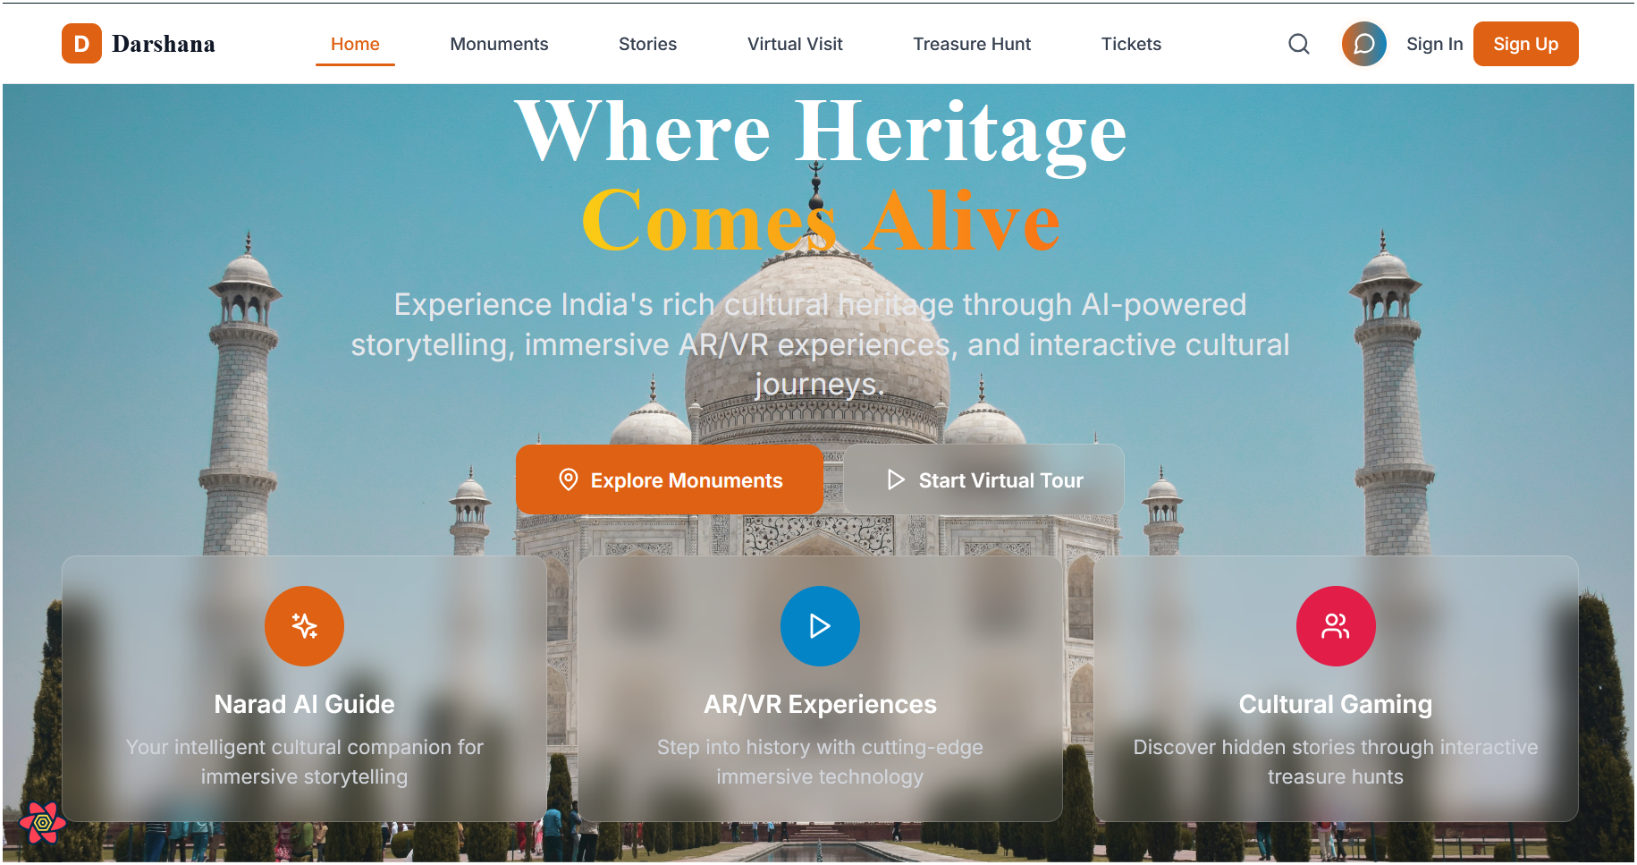
Sample Home page

Slide 13
Future Scope
Darshana will continue to evolve with advanced features and partnerships:
AI-enabled Guide Booking: Users can book real guides whose voices are cloned into Narad AI for hybrid experiences. Video-based tours will also be available.
Advanced AR/VR Reconstructions: Virtual recreations of entire ancient cities like Mohenjo-Daro or Kurukshetra, allowing users to step into history.
Educational Integration: Partnerships with schools, colleges, and museums to use Cultural Darshan for cultural studies.
Global Expansion: Adding myths, folklore, and stories from other countries for comparative heritage experiences.
Gamification Expansion: Multi-site treasure hunts and global leaderboards.

Slide 14
Conclusion
Darshana is not just a platform but a cultural ecosystem. By combining tradition with technology, it preserves heritage, makes learning engaging, and ensures that future generations remain connected to their roots.
Preserving Heritage. Reimagining Storytelling. Inspiring Generations.

